Slide 1
Welcome to the lesson!

Slide 2
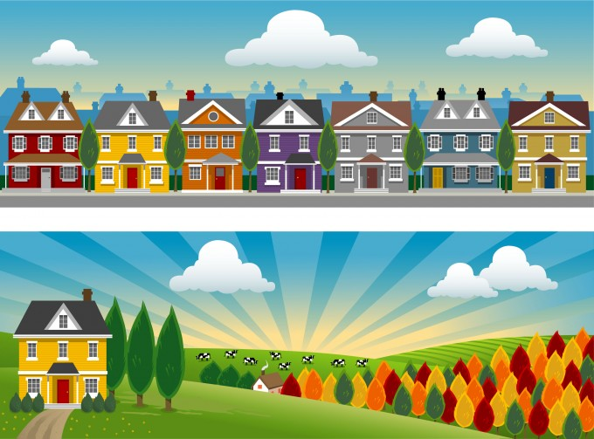


Town or village?

Slide 3

To listen to the ideas about life in the country and in the city
To revise our active vocabulary
To discuss advantages and disadvantages
of life in the country and in the city
Town or Village?

Slide 4

City
High-rise
Village
Fitness
centre
Nature
Shops
Skyscraper
Animals and
Birds

Slide 5
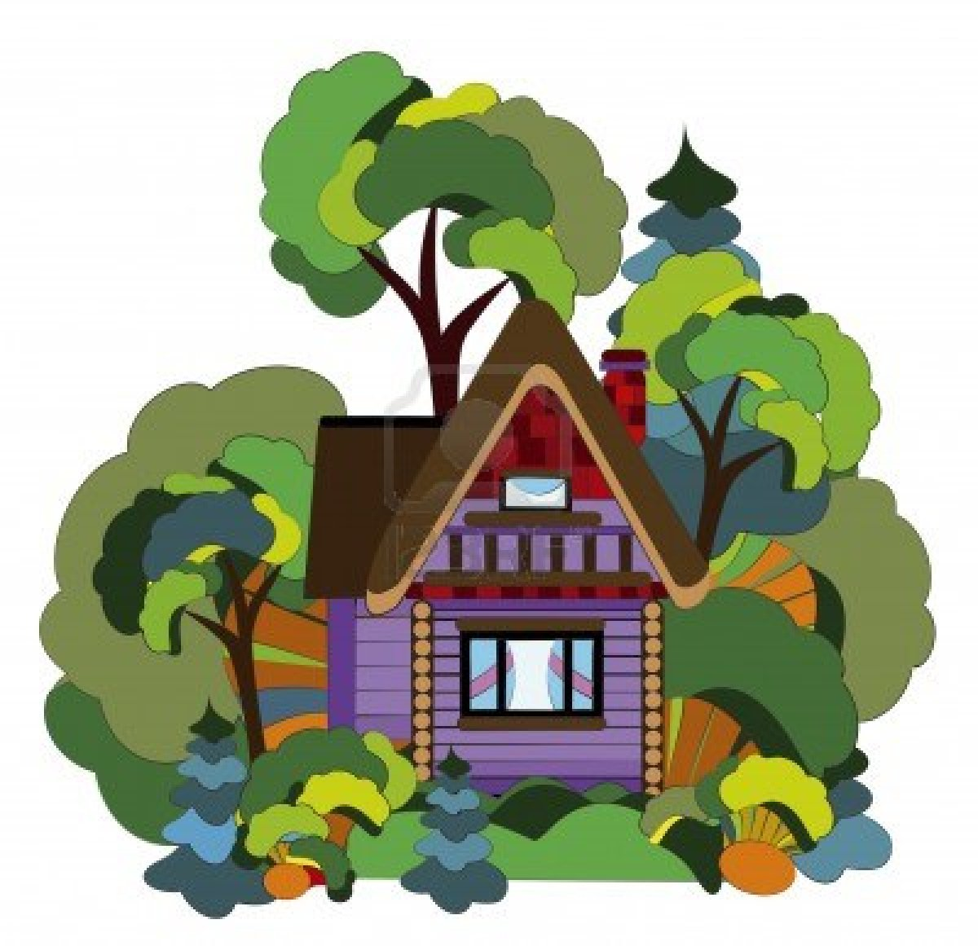
Country
Nature
City hall
Cottage
Animals and birds
Car park
Department store

Slide 6
Read!
Where does he/she prefer to live?
Why?

Slide 7
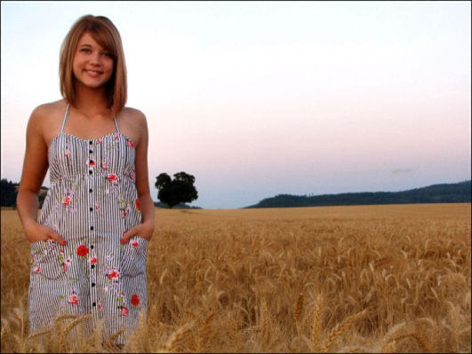
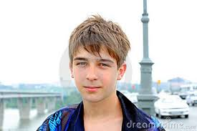


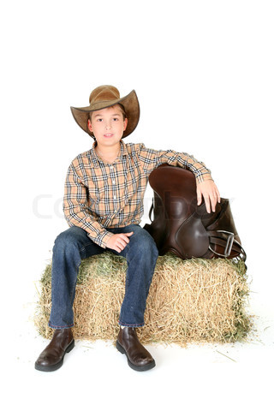
VAL
ALAN
SARAH
JOHN

Slide 8
I would like to live in ... On the one hand,… On the other hand,… As for me…

